Slide 1
How to Build Quality Classes and Objects

Slide 2
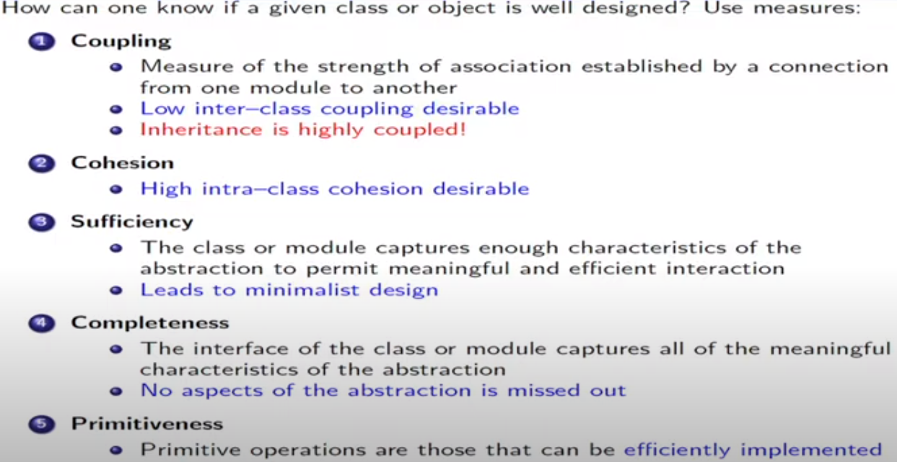
Measuring the Quality of an Abstraction

Slide 3
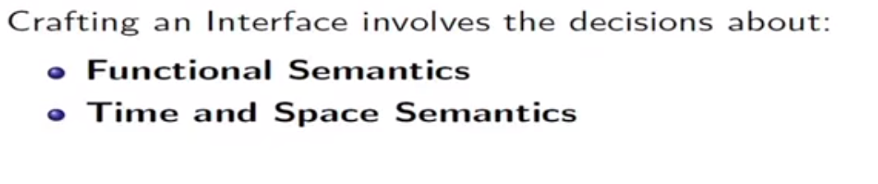
Choosing operations

Slide 4
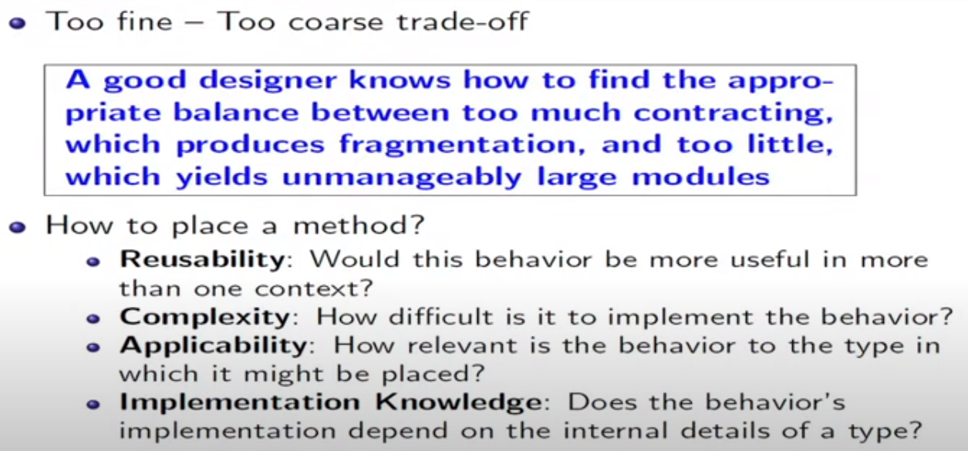
Functional semantics

Slide 5
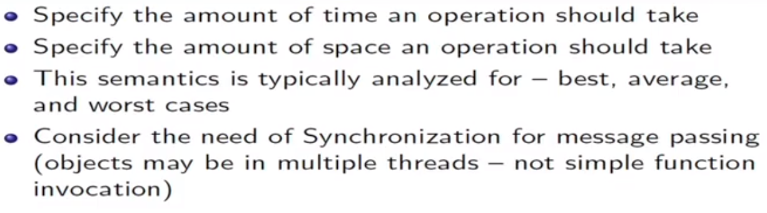
Time and space semantics

Slide 6
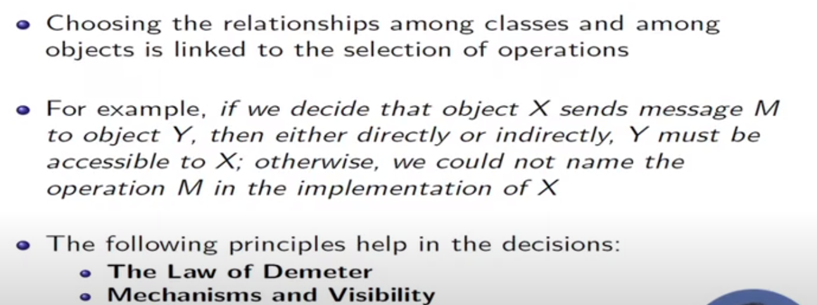
Choosing Relationships

Slide 7
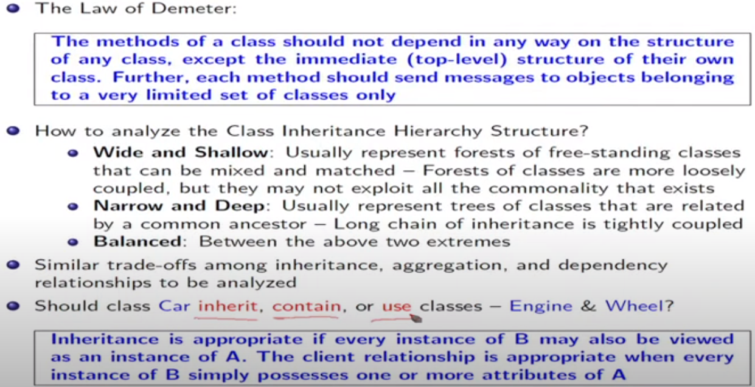
The Law of Demeter

Slide 8
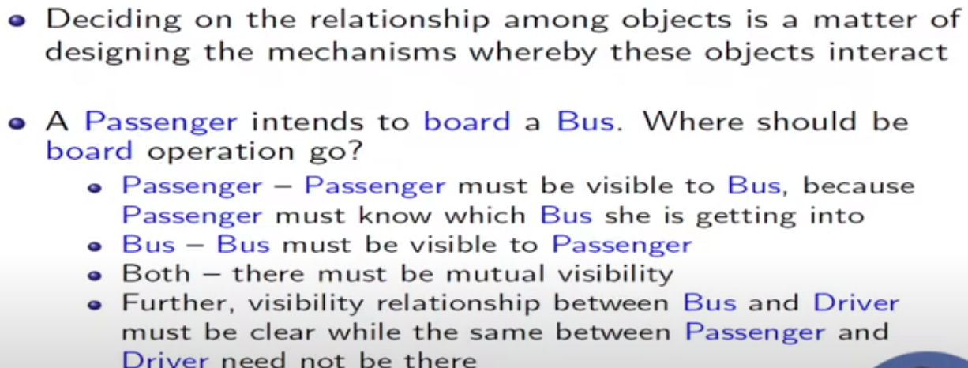
Mechanism and visibility

Slide 9
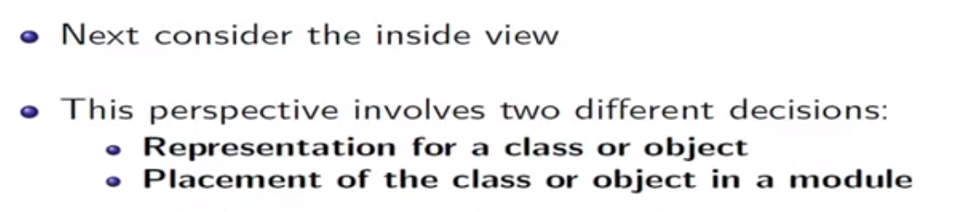
Choosing implementation

Slide 10
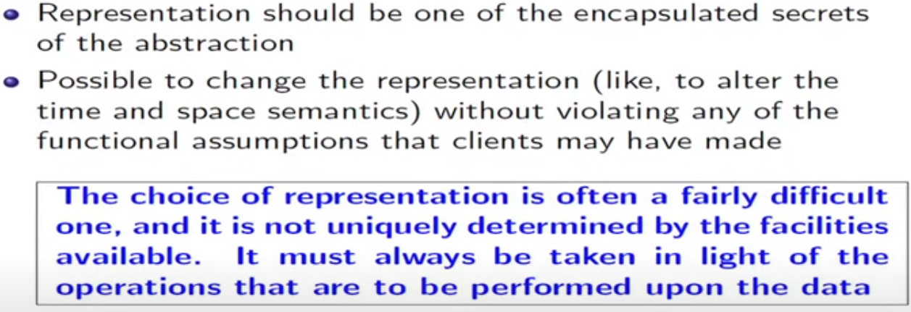
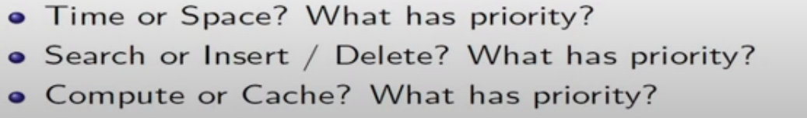
Choosing implementation: Representation

Slide 11
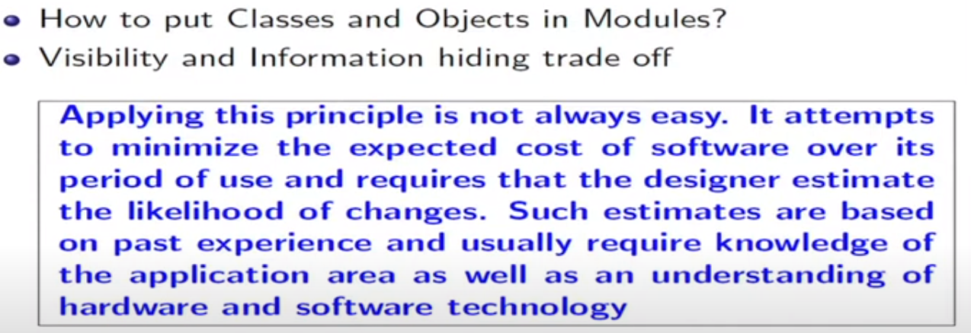
Packaging

Slide 12
How to Identity Classes Objects?

Slide 13
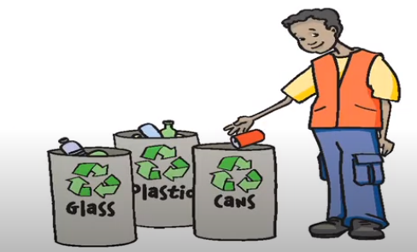
Classification
Classification is the means whereby we order knowledge

Slide 14
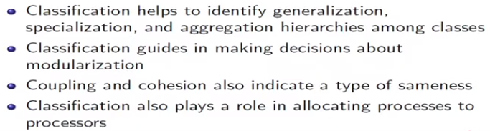
The importance of proper classification

Slide 15
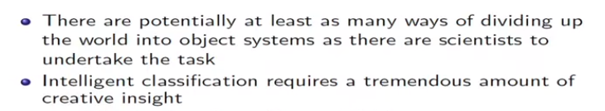
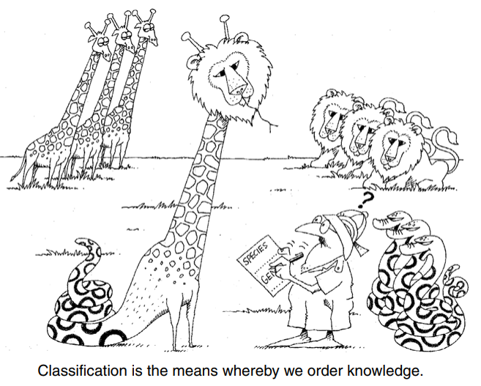
Difficulty of Classification

Slide 16
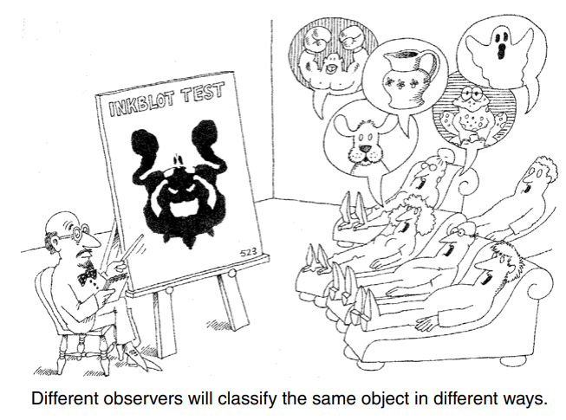

Slide 17
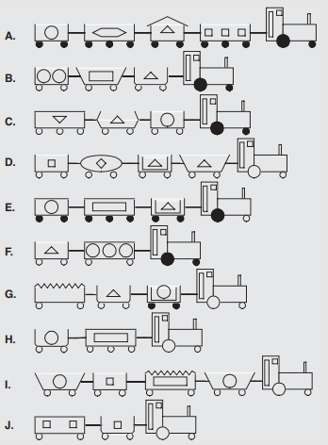
Difficulty of Classification: Example
Create meaningful groups by arranging trains given in the figure

Slide 18
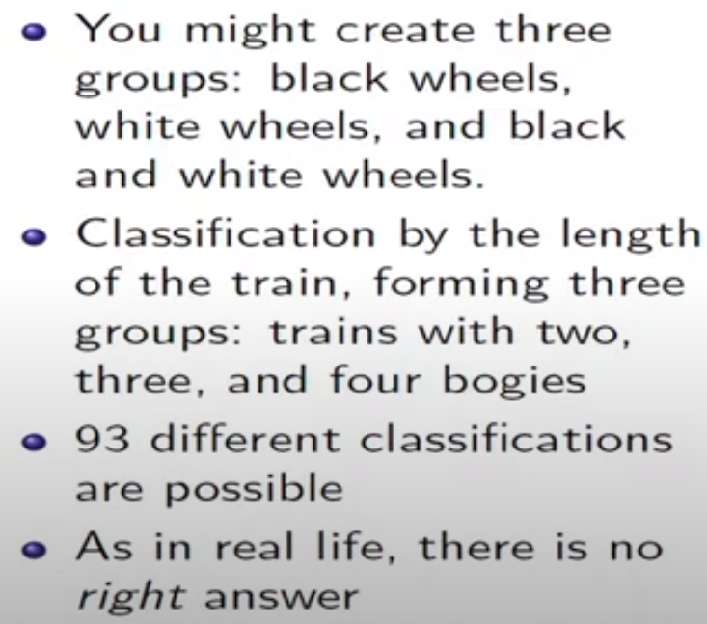
Difficulty of Classification: Example

Slide 19
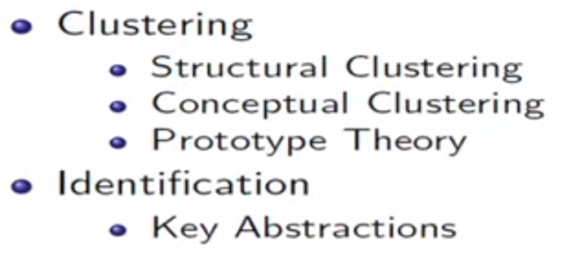
Approaches for identifying classes

Slide 20
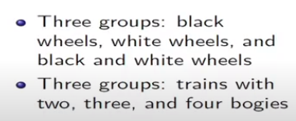
Structural clustering
Divide objects into disjoint sets depending on the presence or absence of a particular property

Slide 21
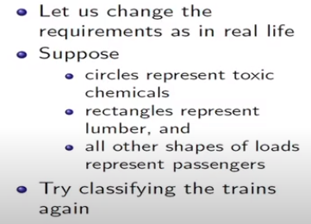
Conceptual clustering
Conceptual clustering is a more modern variation of the classical approach and largely derives from attempts to explain how knowledge is represented

Slide 22
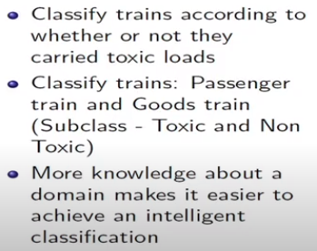
Conceptual clustering

Slide 23
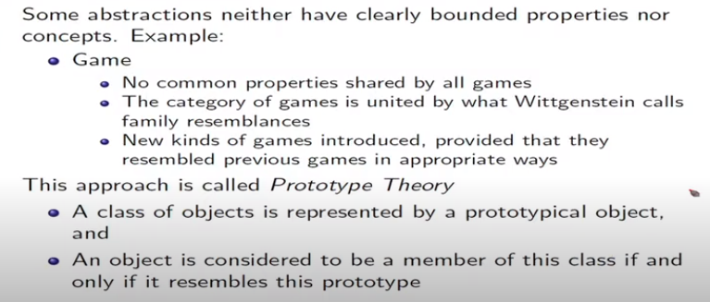
Prototype Theory

Slide 24
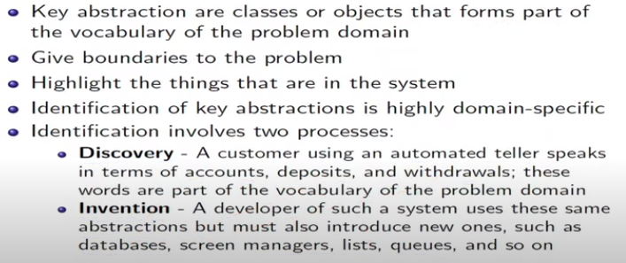
Identification of Key Abstraction

Slide 25
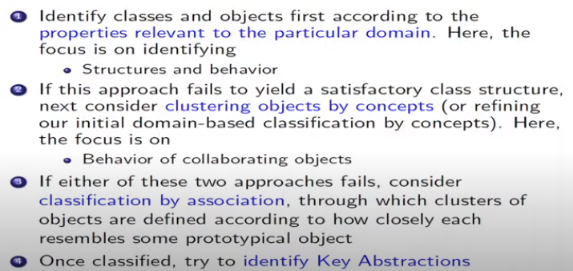
How to apply?

Slide 26
Identification of classes, Objects, and Relationships in LMS

Slide 27
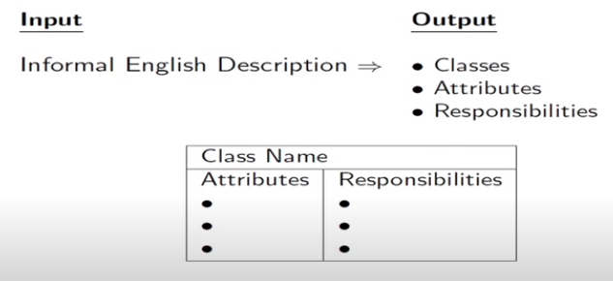
Input and Output Specifications

Slide 28
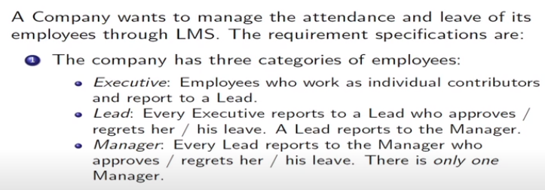
Informal English Description of LMS

Slide 29
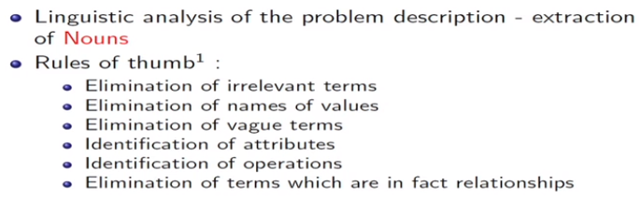
Identification of Noun

Slide 30
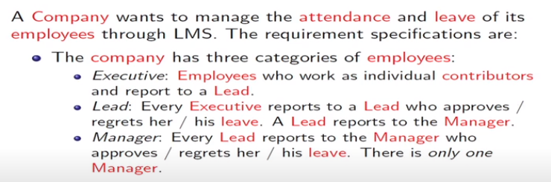
Identification of Noun

Slide 31
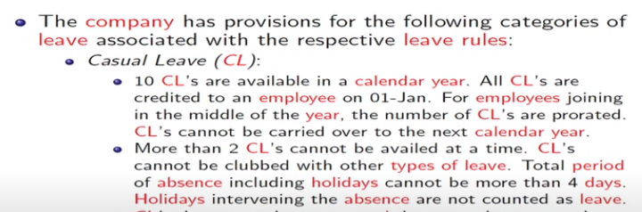
Identification of Noun

Slide 32
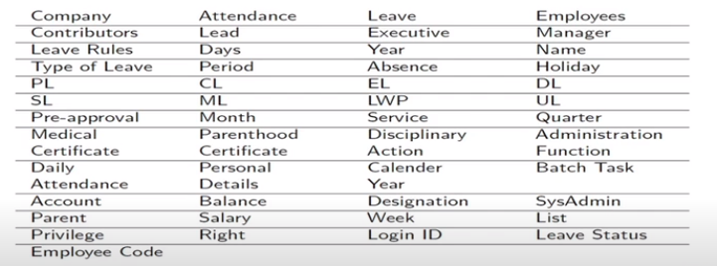
List of all Identified Nouns

Slide 33
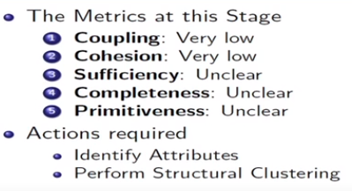
Quality Check

Slide 34
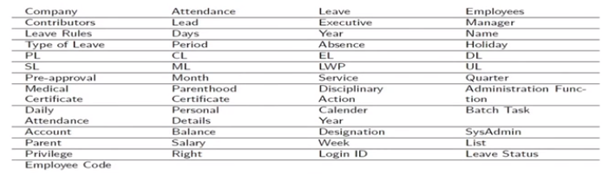
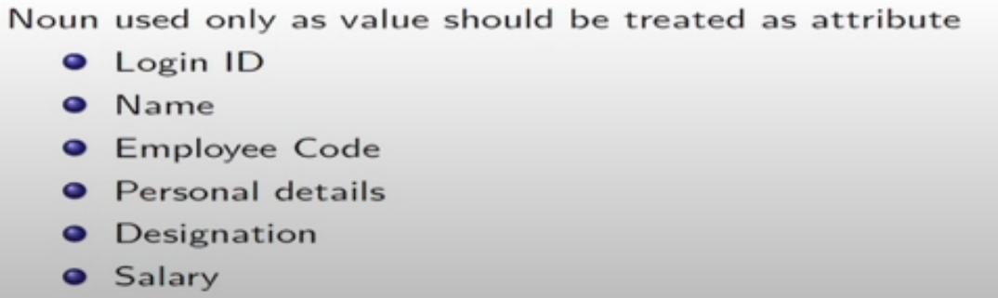
Attributes

Slide 35
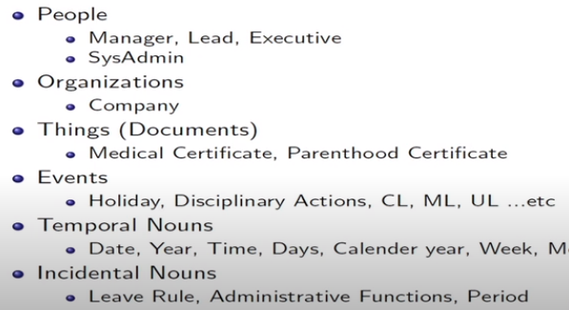
Structural clustering

Slide 36
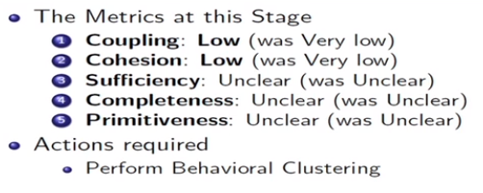
Quality Check

Slide 37
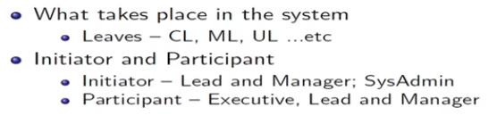
Behavioural Clustering
Dominance behaviours

